Slide 1
Zero to Secure: How We Secured our Environment Without Pain
^MUCH
Notes:
Hello everyone! Welcome to Zero to Secure where I’ll tell you today about how we secured our Mac environment without :click: much Pain

Slide 2

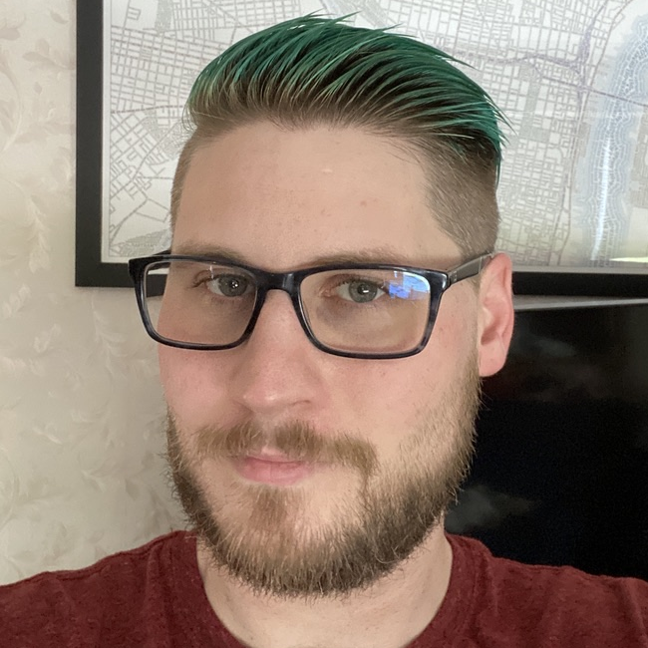


Yo!
I am John Mahlman
Mac Admin for 13 years
Mac Engineering Lead at Leidos
@jmahlman
yearofthegeek.net
Notes:
I am your speaker, John Mahlman. I’ve been a Mac admin for about 13 years now and I’m currently the Mac Engineering Lead for Leidos. Leidos is an international technology and research contractor and one of the top 5 DoD contractors in the US.

Slide 3
Set Expectations
What this presentation is not…
Notes:
Before I start, I want to set some expectations about what this presentation is and what it is not.
This is not a highly technical presentation. I will share some technologies that we used to get our devices up to compliance and some suggestions on scripts and tools, but I will not be taking a huge deep dive into them.
This is more of a project management presentation; I will discuss how we planned the roll out and how we communicated it to users.
So, if you were hoping I’d give you a big script to get compliant, I’m sorry. You still have work to do ☺

Slide 4
Overview
Background
The Plan
Implementation
Lessons Learned
…
Profit?
Notes:
Now that that’s out of the way, here’s a very brief overview of the presentation.
I’ll go over some background; why we’re doing this, what we’re doing, and how we got here.
The planning stages..Implementation of the plan, some lessons learned…and whatever else!

Slide 5
1.
Background
Who? What? Why?
Notes:
Okay, let’s start with some background on the project in general so you can get a scope of work in your mind.

Slide 6
End Goal
Ensure all Macs are managed and secure.
Notes:
Simple goal, ensure all Macs are managed and secure. We needed to do this for various reasons which I’ll get into but basically, we just needed the thumbs up from cybersecurity for all Macs in the environment.

Slide 7
Background - Why
~400-700 total Macs in the environment (?)
~100 Enrolled in Jamf already
Didn’t know where the devices were/who had them
We had ways to find them…
Need to secure devices for compliance
NIST 800-171
CMMC level 3/4
Compliance required to win contracts
Make life easier for users and admins
8
within 12 months
Notes:
Speaking of all macs…we believed we had anywhere from 4-700 macs in the wild with around 100 in jamf already
Now, we didn’t know who had the machines, but we did have some ways to find them (more on that later)
We were asked to secure with NIST 800-171 with the eventual goal of CMMC level 3 or 4
If you’re not familiar with CMMC, it’s The Cybersecurity Maturity Model Certification. It is a unified standard for implementing cybersecurity across DoD and other gov’t information systems. It’s pretty new, 1.0 was releases in January 2020
CMMC level 3 is basically NIST 800 with some added standards. Level 4 is where things get much more difficult, deep discussion is not in scope of this presentation but for more info I’ll include some links at the end
We needed this compliance to win contracts. We’re a defense contractor, higher compliance means more contracts means more business
We also wanted to do this to make life a lot easier for user and admins
Oh and did I mention this was to be done within 12 months? I didn’t? Good because it was actually 8 months….

Slide 8
Background - Why
Enterprise adding more controls for security
MFA
Application Controls
Certificate Verification
Blood samples
Retina scans
PIV Tokens
Notes:
With endpoint compliance comes infrastructure compliance
The enterprise was already implementing these controls…I’ll let you narrow down which ones are real!
Managing these on unmanaged devices is a nightmare for everyone, so getting control of all of the devices allows for us to standardize but also meet those security requirements
It’s a win-win for us and users….
Mind you, these users have been around for a while, it’s not like the Macs are a new phenomenon, they were just ignored…

Slide 9
Background - How
Legacy practices
Legacy tools
Macs not “in scope” for anything
No enterprise-level support
Users “fending for themselves”
Business groups making their own compliance guidelines
Animosity toward IT
Notes:
And some quick background on how we got here…and what it caused…
Some of these go hand in hand, right? Legacy practices and tools….and when they replace those old tools they get something not mac friendly
:click:
This led to things that you’d expect, users and groups fending for themselves to make compliant devices and the lack of support and the introduction of new tools that are not mac friendly led to them just not liking IT and not trusting us

Slide 10
2.
The Process
Make a plan, communicate it, do it
Notes:
Now that we have some background, we had to produce a process to deploy things.

Slide 11

Remember…
every environment is different.
Image source: https://www.apple.com/newsroom/2021/04/imac-features-all-new-design-in-vibrant-colors-m1-chip-and-45k-retina-display/
Notes:
Remember, every environment is different. What I talk about here may not work for you but I hope this at least gives you direction.

Slide 12
Things to keep in mind…
Most Mac users are developers
Pretty tech savvy
Doing development for customers (making $$$ for business)
Don’t break the business
Secure first, enhance after
Not erasing devices
Notes:
Some things that we had to keep in mind based on the information we gathered
First, most of our Mac users are actually developers, they’re fairly tech savvy and they’re doing the work that keeps the company making money
Because of this, we didn’t want to break the business, if devs are not able to use their computers, they don’t deliver products to customers
Our idea was to secure the devices first and then enhance things later. There will be plenty of time to enhance the service after it’s secure…
Based on this info..we decided that :click: we’re not erasing the Macs

Slide 13
On not erasing devices…
Pros
Won’t stop work
No need to collect machines
Faster
Will (hopefully) regain some trust with users
Can always wipe if something goes wrong
Cons
Leave cruft on machines
More prep
Computers coming in unknown state
Notes:
This was a bit controversial internally, but we took the info from the last slide and made some quick pros and cons
I’ll just give you a moment to read this, this is all things you probably know…we thought about it a good deal actually and my colleague and I both had different approaches…but I swayed him ☺

Slide 14
The Process (Simplified)
Find and enroll all Macs in the environment
Develop a deployment schedule
Begin deployment
1
3
5
2
4
6
Inventory and Audit software and hardware
Communicate changes to users
Adjust based on feedback and issues
Notes:
Now that we made some early decisions, we made a roadmap.
Collect and inventory machines, develop the schedule and tell the users and then deploy and adjust! Of course this is overly simplified..

Slide 15
Find and enroll all Macs in the environment
Used various methods to find the devices
Apple Business Manager
Purchase Records
VPN Logs
Anti-Virus Logs
Tickets
Used various methods to enroll the devices
Blog/Forum/Newsletter Posts
Direct Emails to known users
Push with Anti-Virus server
Notes:
The first step was just to find the machines. We used a few method to find them…
Thankfully we had good purchase records and already had ABM, so we knew about most machines…
But we still needed to find who had them so we can contact them, we used infrastructure logs
We had users already using VPN and AV in some cases but still weren’t managed, so we got their info that way and used the various methods there to enroll them
Most of the enrollments were user-initiated but we had some enroll by trying to push an enrollment package via our AV server

Slide 16
Inventory and Audit software and hardware
Collect application information
Identify known not-approved/problematic software
Find non-enterprise security software
OS Inventory
Hardware inventory
Do we need to retire any devices?
What kind of performance issues will we run into?
What models are “most popular”
Notes:
Once we started to get the machines in, we started inventory of software and hardware
We needed to ensure the software was okay to keep on the systems and sort of more importantly, we had to ensure we were not going to install another security suite on top of an existing suite
We wanted to see how the OS breakdown was, we only wanted to support Mojave and Catalina but we had systems with 10.13 and a few with 10.12, so we had to figure that out as well
As for hardware, we wanted to make sure the machines were ”good enough” to run our security stack but also ensure that when we manage them the performance hit wouldn’t be too bad
We also wanted to make sure the systems can run 10.14 at a minimum and if not, we’d retire them
Lastly, we wanted to see what was the “most popular” models
We would use this to determine which machines we would offer for purchase in our hardware catalog (spoiler, 15-inch MBP was the most popular by a long shot)

Slide 17
Develop a deployment schedule
Why not just push a button?
Notes:
Alright, we have the machines enrolling, we have inventory being analyzed, now we wanted to figure out how to deploy the security settings and software updates!
We knew the baseline we were using, we had almost all of the software we were going to use chosen already, why not just push a button to make everyone compliant? Well, we could do this for new devices, but those existing ones…

Slide 18
Just Push everything out!
Notes:
Think of an iceberg. We see the tip of the iceberg and we know there's a little bit underneath but we’re really not sure how much is hiding there.
We push that button :click: and suddenly the entire thing shows up at one time and now, we’re under water. We know ice bergs can sink ships and we didn’t want to have that happen.

Slide 19
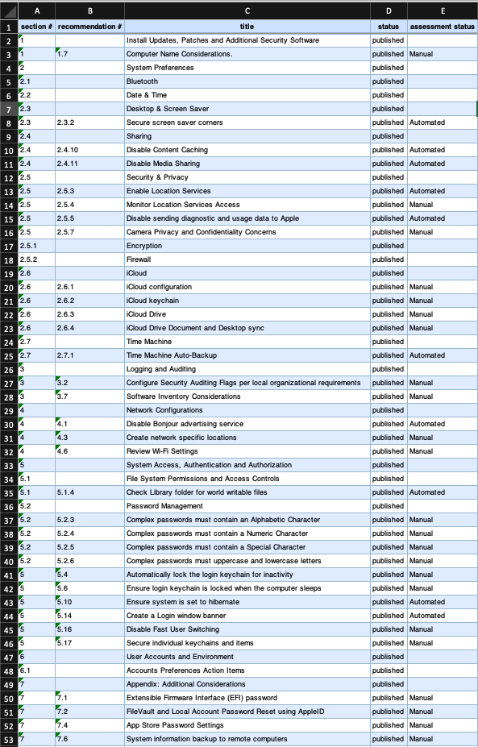
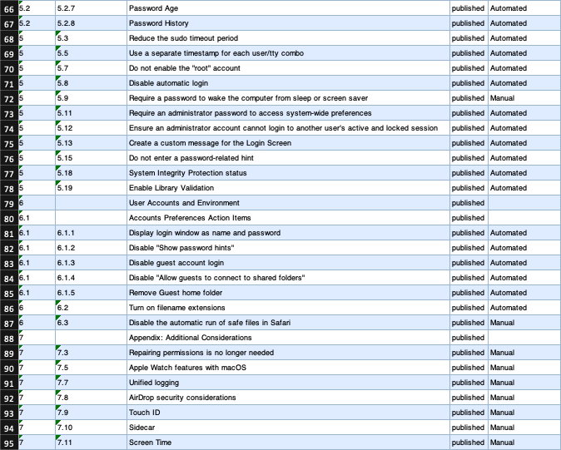
Why not just push a button?
Notes:
In case you’re not aware, this is a list of what controls get put in place on an endpoint when you deploy CIS level 1.
We required level 2 which has more…but this also doesn’t consider of the software needed for compliance
We have to test and deploy things like cmdReporter, Anti-virus, firewall, and this is not even considering OS updates and software patching which is also part of security enforcement
So yeah, pushing a button was out of the question….
What we decided to do was break down the controls using some metrics and deploy in waves!

Slide 20
Define Metrics
User Impact
How much impact will this cause to the user once implemented?
Ease of Deployment
How easy is the control to deploy?
Level of Security
How much more secure does the change make the machine?
Notes:
We defined three basic metrics:
In order of importance in our decisions: User impact, Ease of deployment and level of security
How much is this going to affect the user? We weighted this heavily in the beginning. We decided to basically deploy all settings that didn’t affect the user a lot in the beginning.
How easy is the config to deploy? Config profiles are easy to make and deploy, scripts are harder. AV installs are simple but tuning them is really difficult and time consuming..so maybe not a good thing to do first. We also decided to say “if these three settings are in the same config profile…let’s just try to add the rest that are needed”
And last, how much more secure is the device after implementation. Deploying a config to show a Login window message doesn’t make the device much more secure, but enforcing filevault does.
So now, with the metrics defined, we took a look at the settings we had to deploy and started “scoring”. Keep in mind, we didn’t have a number value associated with each of these, it was more of an ad hoc scoring system but I’m sure you can probably define some scores for these if you really needed.

Slide 21
Deployment Graph
Hard to Implement/High Impact
Browser Settings
Endpoint Security (AV/ATP/FW)
Enforce OS Updates
Disable iCloud
Enable File Vault
Disable SSH
Security compliance Script*
Software Patching
NoMAD
Disable httpd
Disable Screen sharing
Disable Network sharing
Login Window Settings
Unbind Macs
Disable Print Sharing
ADE
Enforce Gatekeeper
Forensics Software
cmdReporter/Splunk
Vulnerability Scanning Agent
CUSTOMER IMPACT →
Backup Program
EASE OF DEPLOYMENT →
Config profile
Policy Change
Project
Application
Script
Radius = Level of Security
Notes:
We took our metrics, and we started plotting things out…
Now, this isn’t every check…it’s not even a quarter of the checks, but this was the idea.
You can see the legend there…
We grouped things as best we could based on where they fell in the chart here. So :click: wave 1 here was all the simple, unobtrusive settings…lots of config profiles and silent agents that usually don’t affect the user. You can see cmdReporter and Splunk, our enterprise backup solution, but also disabling of all of the sharing macOS has.
:Click: Wave 2 was more configs and some scripts…these were more user facing changes and things that users may be upset with…disabling icloud, changing browser settings, things like that
Finally, the third wave are things that take time to do and will be very noticeable to the user. Our AV, unbinding the Macs so we can use automated enrollment…and wave 3 was also used for cleanup and adding anything we removed from previous waves based on user feedback.
Now…:click: there are 2 here that are marked as “Project.” Enforce OS updated and software patching. We basically broke these down into their own sub-projects with their own schedules. We also knew that these would continue after the main project to secure the environment. These were a mix of “secure and enhance”. When I go over lessons learned, you’ll see why this was very important.

Slide 22
Timeline
Have all known Macs enrolled with Jamf, communicate changes to users
Security Compliance Wave 1
Security Compliance Wave 2
Security Compliance Wave 3
Q4
JAN
FEB
MAR
APR
MAY
JUN
Q3
Begin software and hardware audit of enrolled devices
Communication to users
Refine and adjust based on feedback
Refine and adjust based on feedback
Notes:
Now that we knew how many waves we needed..we made our timeline and we were ready to start communicating things out!

Slide 23
Communication advice
Let them know about things they will notice immediately
Notify users about major policy changes
Don’t list every change
Collect feedback
Communicate using different mediums
Don’t use technical jargon
Try to give the “positive impacts” of the changes
Communicate every wave
Notes:
A good communication plan is a requirement for successful deployment
A few pieces of advice with regards to creating an effective communication plan
When communicating, you want to let your users know about very noticeable changes and major policy changes…but you shouldn’t let them know every little thing
You should let users know about changes like a login window privacy policy or installing a new application (even if it’s not right in their face)
You rally want to let them know about things like screen lock time and of course AV installation…these are things they care about, and they’ll notice.
You don’t need to tell them you’re installing a log forwarder or adding a shell MOTD
Your list may vary of course
You want to send out the comms with enough time for users to take in the info and provide feedback, remember…even bad feedback is feedback, and you should take it all into consideration
An example here: we communicated out that we were disabling screen sharing using VNC in wave 1, we received feedback that lots of people used this functionality for collaboration…we gave the users advice on new solutions and we told them we’re moving it to wave 2. The users were happy, we were happy.
And one very important one that often gets overlooked: give positive impacts of the changes
Yes, you’re taking some things away and altering settings of machines but there are many positives to this
“We are pushing an updated Office client to your machine so that you can have all of the most updated features and to ensure you can get support when needed”
“We’re deploying NoMAD to your machine so that your local password can synchronize with your network password, you only need one password!”
“The backup solution will be deployed to ensure your data is safely backed up in the event of a problem.”
Remember, we’re trying to rebuild relatinships…and this is one good way to do that.

Slide 24
3.
Implementation
Do all of the things….in waves!
Notes:
And finally, it’s time to implement the changes. You panned and planned, and you’re ready for wave 1!

Slide 25
Deployment
Tools used:
Jamf Pro
Jamf CIS Scripts (customized)
Config Profiles
Various scripts
Vendor provided packages and scripts
Notes:
We used our Jamf pro server to deploy everything here
The Jamf CIS scripts worked very well for us but we customized a bunch of checks and also made different remediations based on each wave.
The config profiles were a mixture of using the built in Jamf UI and making our own with Profile Creator or the later tool of iMazing Profile Editor, cannot recommend them enough..make sure you sign your profiles before uploading to jamf
You will need to make custom profiles…jamf has updated the UI to allow much easier custom application config profiles, use them where possible
We used various scripts found on Git provided by the community and we also found we had to write out own to do some things
Some of our security vendors provided some packages, config profiles, and scripts
Make sure you look at these closely before deployment, I use suspicious package by mothersRuin to look at every vendor supplied package…I cannot tell you how many times I’ve had to send packages back to them because they had issues

Slide 26
So…
Who goes first?
Notes:
So you have your tools set up..now..who goes first?

Slide 27

Early Adopters
Source: https://www.incimages.com/uploaded_files/image/1920x1080/getty_143177000_136401.jpg
Notes:
Early adopters.
That’s us watching the early adopters to make sure they are not being hurt

Slide 28
Early Adopters
Find them early
Get a good mixture of user types
IT staff make great early adopters
Communicate and follow-up
Notes:
This is important..when I was demoing this presentation to my partner she told me to make this really stand out…so I gave it it’s own slide…:click: with animations!
Find your early adopters early in the process. This should go in the lessons learned, but I’m making sure that you know this…find your early adopters early.
Find a good mixture of your user types…if you have a lot of devs and a few art directors, get a handful of devs and one art director to be an early adopter. Take a good percentage of your environment and directly email them and ask them if they can be an early adopter. We have 17 early adopters…but we also have 17 users in the IT department that get things early. That’s another good built-in testing group…IT.
Whomever you choose, communicate and follow-up….make sure they know they’ll be be getting changes before everyone else..maybe a week or 2. Make sure they know things may break…but also make sure they have a direct line to you to immediately fix something if you break it.
Always follow-up with them…ask for feedback, interact with them. These users are your last line of defense from pushing out a work stopping change.
They can save your users from disaster and save you from losing your job.

Slide 29
Timeline (Revised)
Begin patching and OS updates project
Security Compliance Wave 1 (EA)
Security Compliance Wave 2 (EA)
Security Compliance Wave 3 (EA)
Have all known Macs enrolled with Jamf, communicate changes to users
Security Compliance Wave 1 (Everyone)
Security Compliance Wave 2 (Everyone)
Security Compliance Wave 3 (Everyone)
Q4
JAN
FEB
MAR
APR
MAY
JUN
Q3
Communication to users
Communication to users
Communication to users
Begin software and hardware audit of enrolled devices
Refine and adjust based on feedback
Refine and adjust based on feedback
Notes:
Now our updated timeline shows each wave, each early adopter deployment, and each communication.
Obviously, this is overly simplified, but it’s a really good skeleton for a deployment.
Note that we added the “patching and OS project”, that was when we decided we needed to get a handle on the OS updates to ensure a good roll out of controls.

Slide 30
$48,000
1
75%
Under budget
Data loss incident
Decrease in vulnerabilities per machine
Notes:
Okay, the end of the project….by the numbers. Our rollout was a rousing success!
We completed the project on time and under budget by about $48000. We completed wave 2 much late than planned but wave 3 was completed just before the deadline…so we called that a success overall.
We did have 1 Data loss incident…now we don’t know if this was user error or caused by the changes, but we found it to be important enough to report on
And thanks for Nessus scans and patching we saw a 70% decrease in vulnerabilities in the environment. More on that…

Slide 31
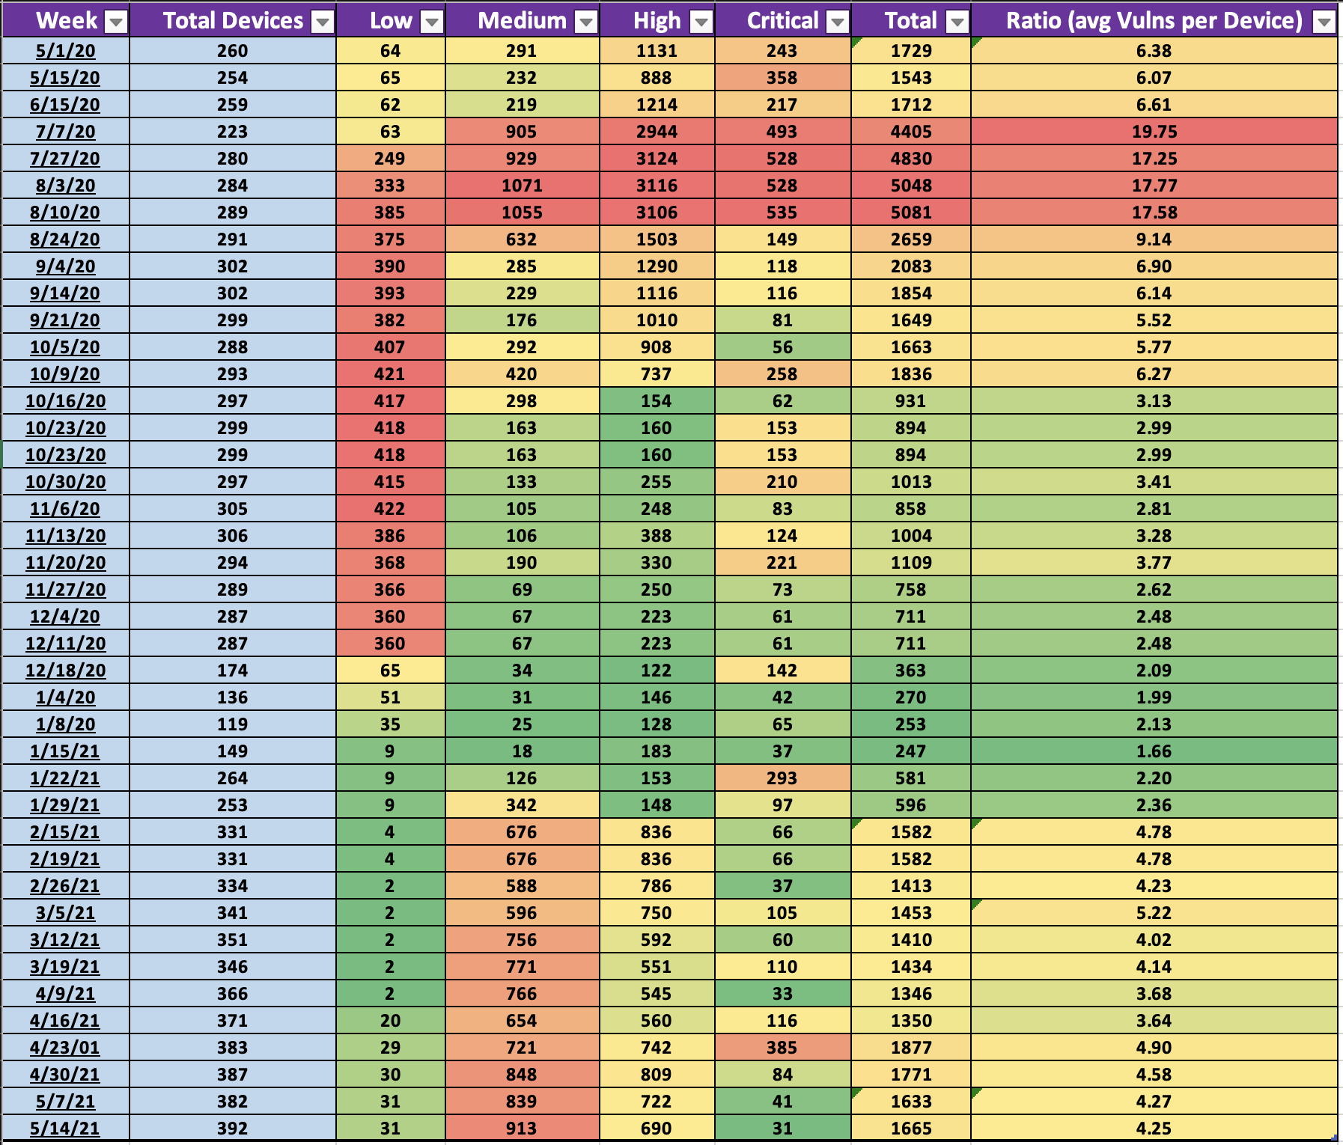
Notes:
These are our actual vulnerability scan results… we went from a high of 19.75 per endpoint when we only had 223 devices….to an average of 4.25 in 392 devices.
A note about some of these…since there are some weird patterns here I want to explain.
:Click: Here, we found a vulnerability with a piece of security software…it was patched in December.
And here…:click: we see the Apache vulnerability in 10.14 and 10.15. Apple patched it the week after listed…so some of those numbers are a bit off
Keep in mind, some of these are also right after an OS update was released or a Chrome zero day was found..but still overall, good numbers!

Slide 32

Lessons Learned
Identify early adopters first
Focus on patching separately
Write more KBs and user support docs
Find support people to help
It’s better to be late than wrong
Don’t ignore Macs!
INVEST
Notes:
So what did we learn throughout the project? What could we have done to make things better?
Find your test group early…basically find them right as you’re enrolling devices…if you already have devices enrolled…find them now
As I mentioned before, patching ended up being a separate project bt we didn’t realize it until a few months in. We should have identified someone to tackle packaging software updates and packages instead o doing it ourselves while also securing the platform. Yes, they’re part of the same goal…but patching takes a lot of time and you can very easily train someone how to package software and deploy it. If you’re lucky enough to have an operations team or person, use them and start early.
I didn’t have time to go into this today, but you should be providing KB articles and other user support docs with your communications…and if you think you have enough, write a few more. It’s never enough!
This is especially important when you’re introducing new apps and settings to both your users and the support staff
A good time to mention…take the time to identify support champions..people who express interest in supporting macs..this will help free you up from things like helping users with printers or basic troubleshooting
We focused a lot on schedule and because of this, we had a data loss incident. Again, we didn’t know if it was our fault, but we knew that we rushed some controls and changes..either way, we knew we could have hanged something when it happened..and we did.
That last bullet is more of a general lesson learned for big corporations…:click: Don’t ignore macs. Invest in them! If you have Macs already, the longer you ignore them, the harder and more expensive it becomes to fit them into your environment.

Slide 33
Thanks!
Any questions?
@jmahlman
yearothegeek.net

Slide 34
Resources
Jamf CIS Scripts: https://github.com/jamf/CIS-for-macOS-Catalina-CP
macOS Security Compliance Project: https://github.com/usnistgov/macos_security
CMMC Website: https://www.acq.osd.mil/cmmc/
NIST 800-171 Rev. 2 Documentation: https://csrc.nist.gov/publications/detail/sp/800-171/rev-2/final

